Slide 1
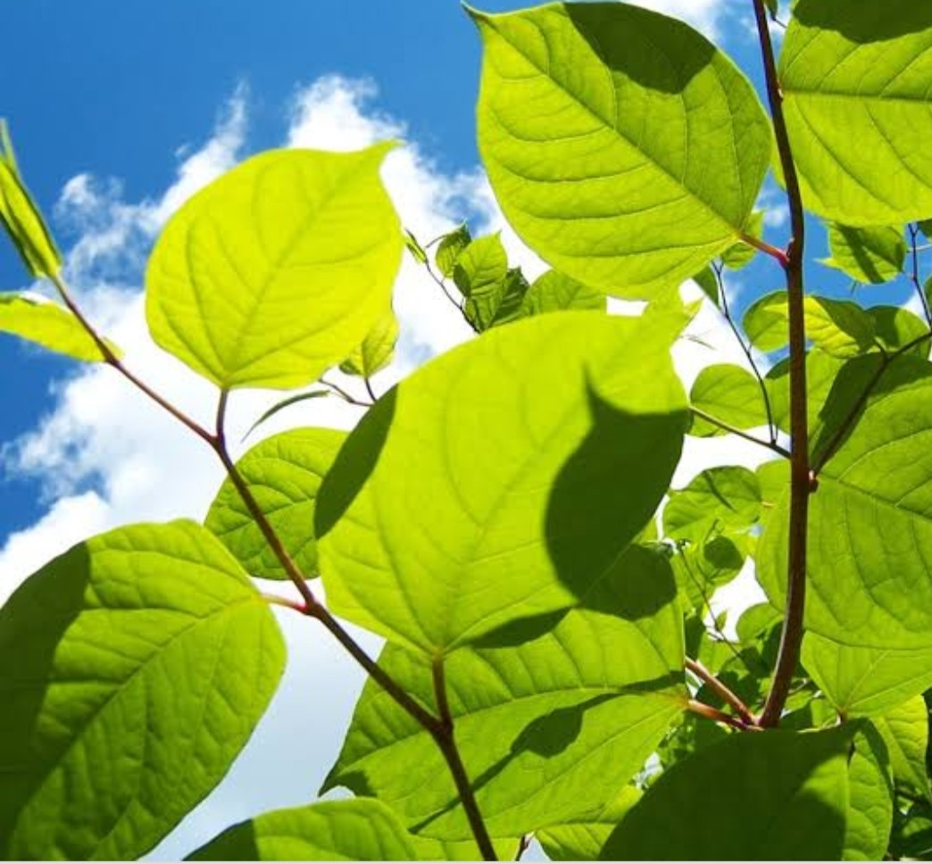
Plant Seedling Classification
Team Member : Rashika N
Navami B G
Anusha A R
Ashikhatter S
Arpitha M C

Slide 2
Introduction
The agricultural sector has recognized that for crop management to thrive, acquiring relevant information on plants is needed. However, studies have shown that agricultural problems remain difficult in many parts of the world due to the lack of the necessary infrastructures. Using a dataset of plant images that consist of descriptions under a controlled condition concerning camera radiance and stabilization. This paper uses a convolutional neural network for training and does data augmentation to identify 3 plant species. In future works, we plan to utilize the model by training it to other types of plants like herbalmedicinal plants and other crops in other countries. Moreover, the proposed method can be integrated into a mobile application with the goal to proviide farmers efficient farming practices

Slide 3
PROJECT DESCRIPTION
In recent times, the state of agriculture and the amount of work people need to put in to check if plants/food is growing correctly is phenomenal, because it is 2020 and workers still need to organize and recognize the difference between different plants and weeds. People who are working in the agriculture field still have to have the ability to sort and recognize different plants and weeds, which does take a lot of time and a lot of effort in the long term.This is where Artificial Intelligence can actually help benefit those workers, as the time and energy to identify plant seedlings will be much shortened. The ability to do so effectively can mean better crop yields and in the long term will result in better care for the environment. As by identifying the difference among the plants and weeds in a timely manner where it is highly accurate can positively impact agriculture.

Slide 4
In this work, we explore the performance of traditional computer vision methods on this task and show that a Deep Convolutional Neural Network (CNN) does the best job at classifying plant seedlings. In this work, CNN is adopted for plant seedling classification to automatically discriminate between weed species and crops at early growth stages. . In this project by using AI system will make a machine to identify the plant seeds from the weeds, so this was helpful to the farmers and they can identify the crop growth or plant seeds from weed.
PROPOSED SOLUTION

Slide 5
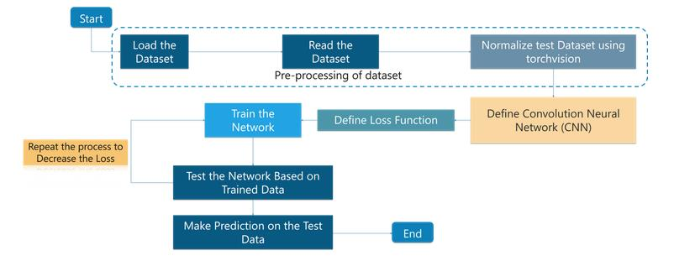
Flow Chart

Slide 6
Software Design
Jupyter Notebook Environment
Spyder Ide
Deep Learning Algorithm (CNN)
Python
HTML
Flask

Slide 7
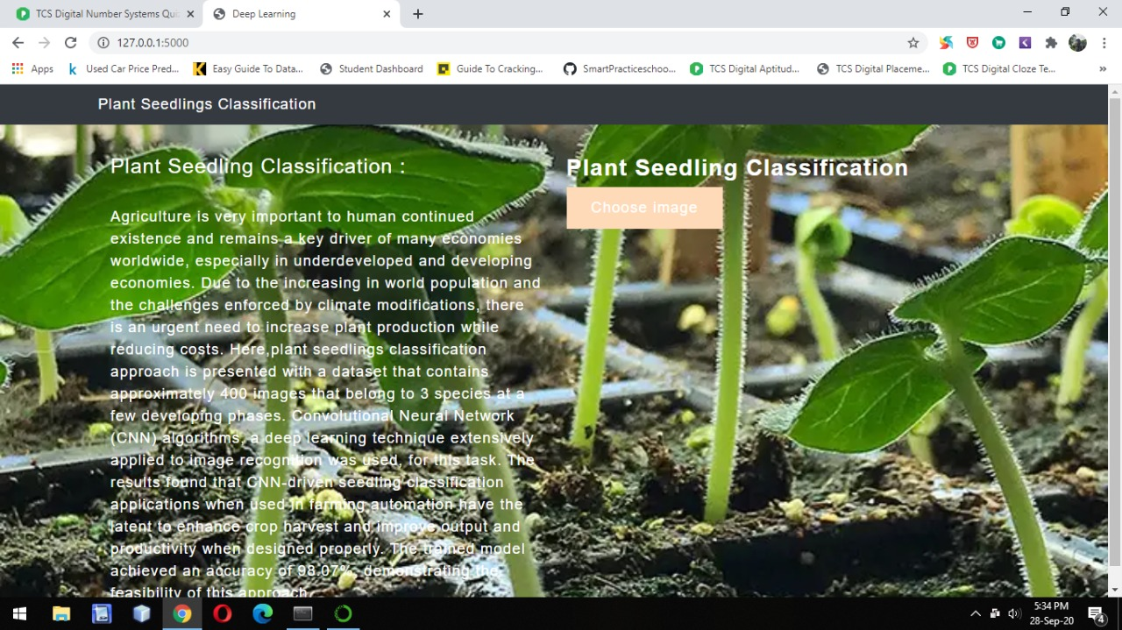
Outputs for the prediction

Slide 8
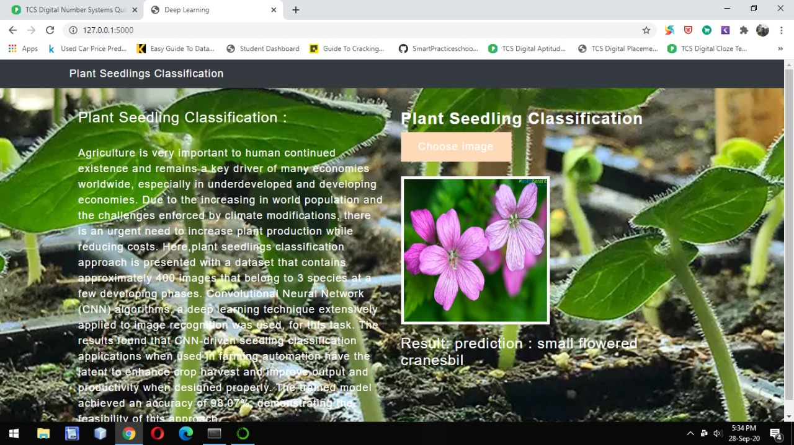

Slide 9
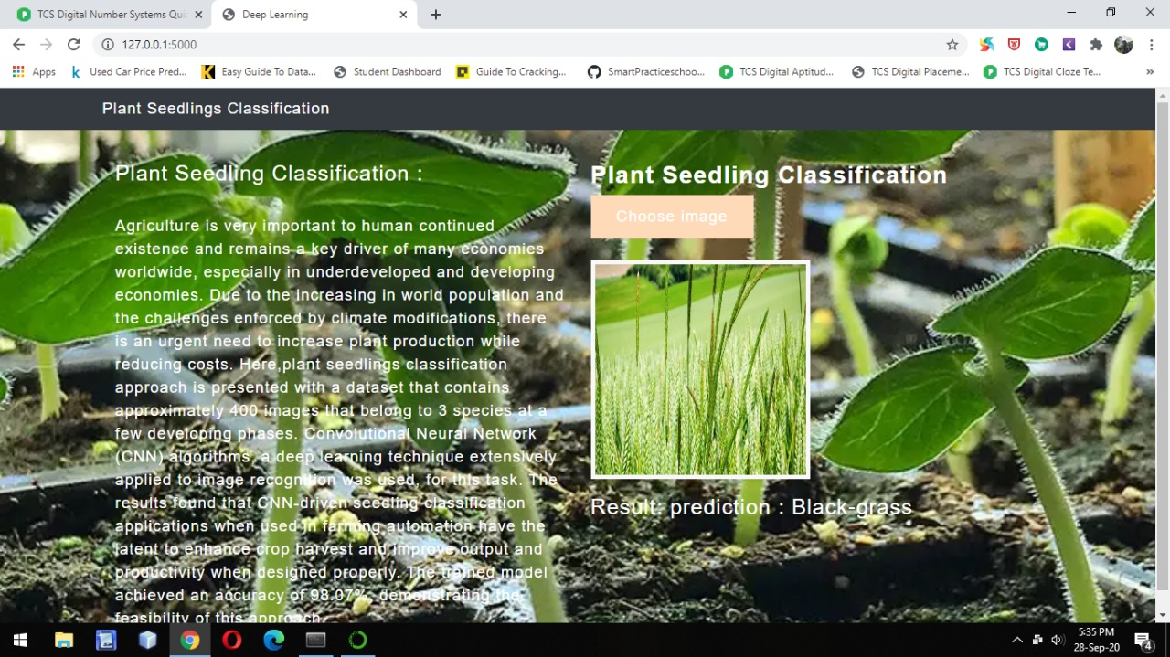

Slide 10
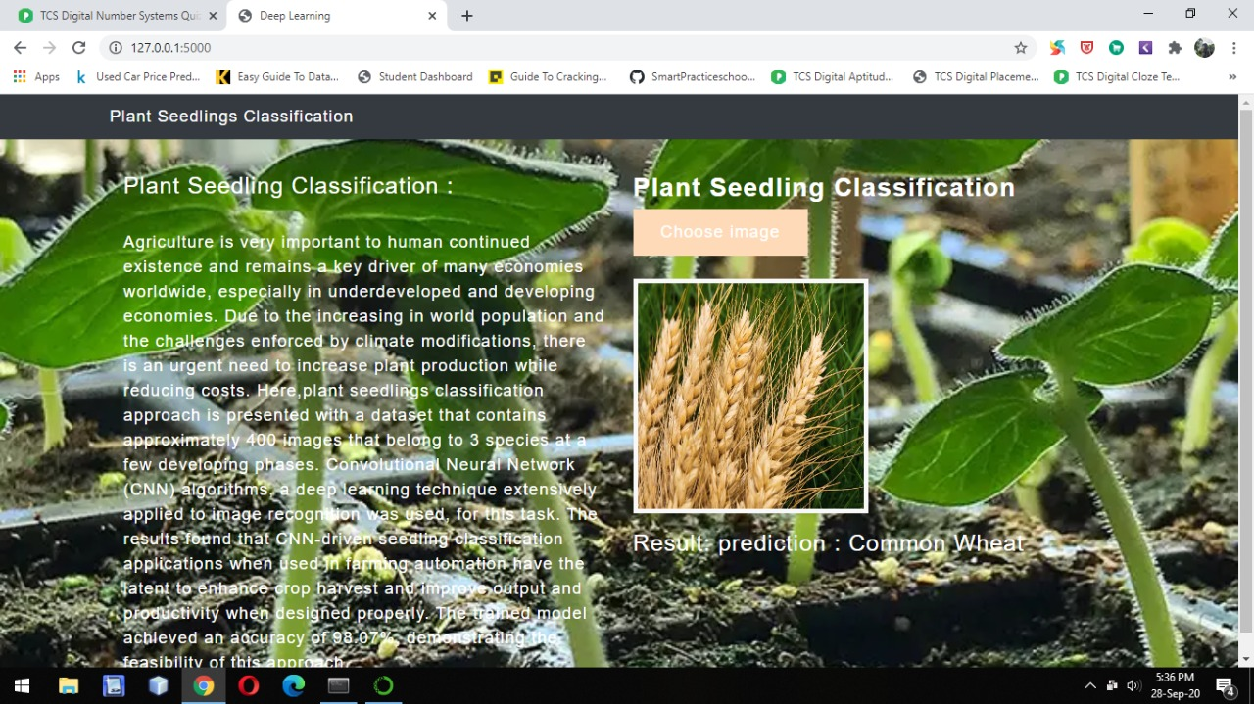

Slide 11
CONCLUSION
Throughout the process of developing the CNN model for plant seedling classification , we have built a model from scratch which consists of 5 layers and follows with a fully connected neural network. Then the trained model is evaluated using separate unseen data to avoid bias prediction. As the result, the accuracy of the test dataset reached 98.07%, loss is 93.30%, val_loss is 45.13% and val_accuracy is 83.33%which indicates a decent model. This mini-project allows a beginner to obtain an overview of how to build a model to solve a real-world problem.

Slide 12
THANK YOU

